Slide 1




Data Structure Course Design
A Distributed Task Scheduling System
Based on Priority Queue and Set
2024.6.21

Slide 2

01
Requirements
Content
02
Data Structure
03
Core Codes
04
Show Results

Slide 3
Requirements

Slide 4


Requirements
Develop a distributed task scheduling system using a priority queue as the data structure for task scheduling.
System Design
1. Support for task submission, scheduling, and execution
2. Consideration of task priorities and dependencies
3. Support for monitoring task execution status and fault recovery

Slide 5
Data Structure

Slide 6
Design Principle
Requirement: Priority and dependencies
Function: In our project, we use priority queue to store tasks. Every task has its own priority (a number, smaller number, then higher priority). For dependencies, we consider the following two points: ①Must Precede Task: All tasks within the set must be completed before proceeding with the current task; ②Select predecessor tasks: Before proceeding with the current task, one or more tasks within the collection must be completed. These two dependencies are all stored in sets.
Requirement: UI for user operation and visualization
Function: We use PyQt5 to design UI. There are input boxes to input the information of tasks. There is a grid to visualize the execution of each task, when a task’s rest time is n, then there will be n colored block representing the rest time (one block = one second).
Requirements: Error
Function: We simulate task runtime error with probability. Random a float number between 0 and 1, if the number is smaller than the probability, the task encounters an runtime error. In addition, if the input is incorrect, there is an error.

Slide 7
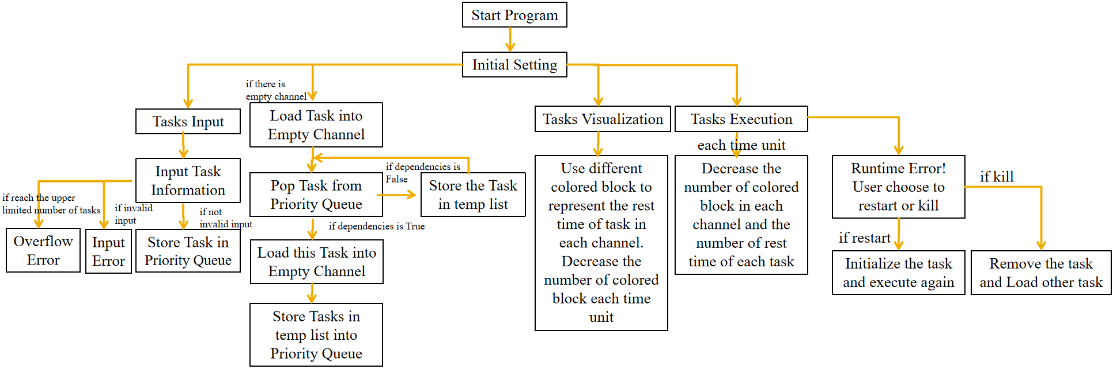
Model Flow Chart

Slide 8
Core Codes

Slide 9
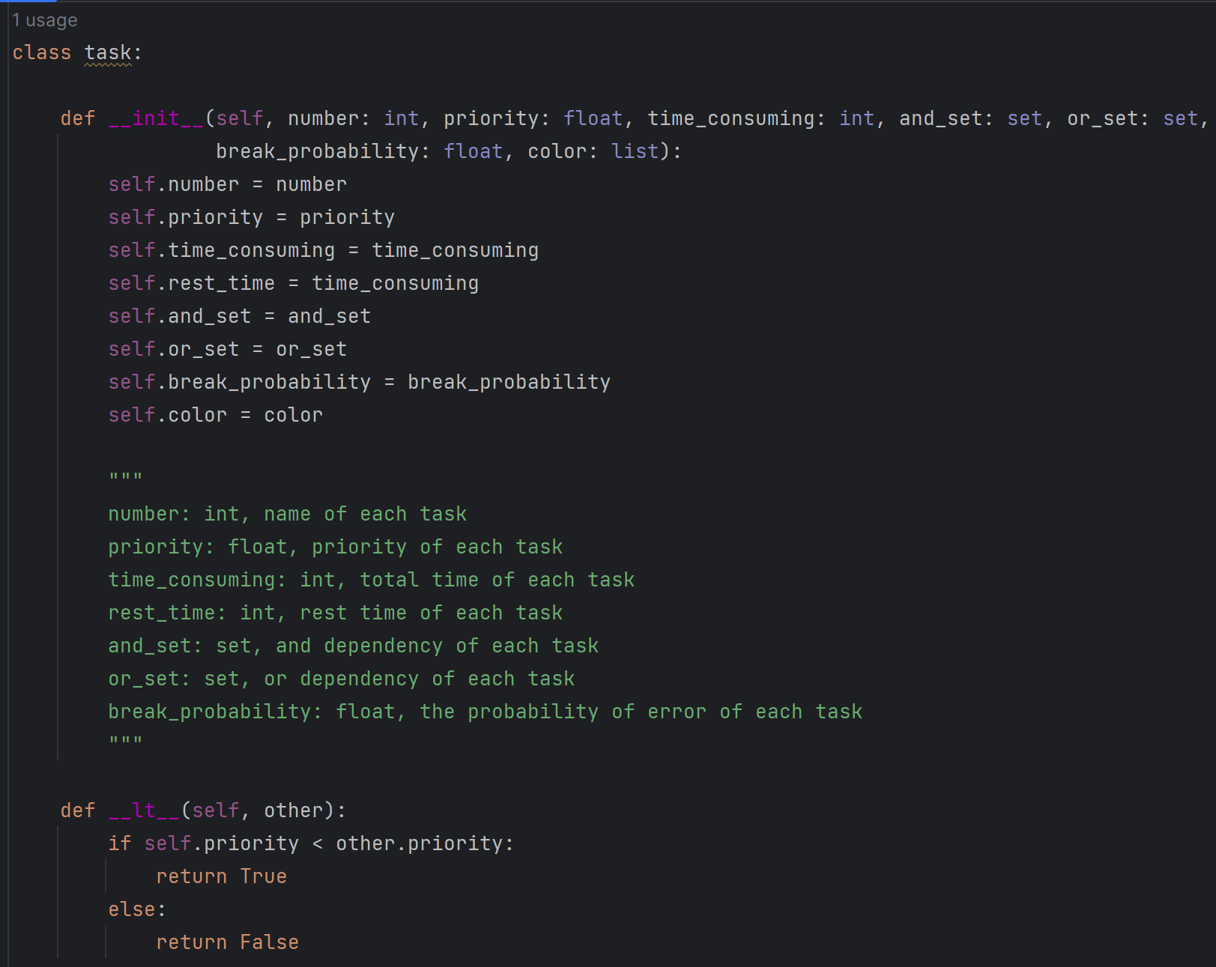
Priority queue: pop out the element with the highest priority. Each task is an instance of class “task”, and has a attribute named “priority”. In order to realize comparison between two tasks, we rewrite the method “__lt__”.
Set: manages the dependencies. When there is a task loading into channel, program will check if the dependencies condition is satisfied by traversing “and set” and “or set”. If there is one flag of element in “and set” is False or there is no flag of element “or set” is True, then the task cannot be loaded, else the task can be loaded.
1

Slide 10
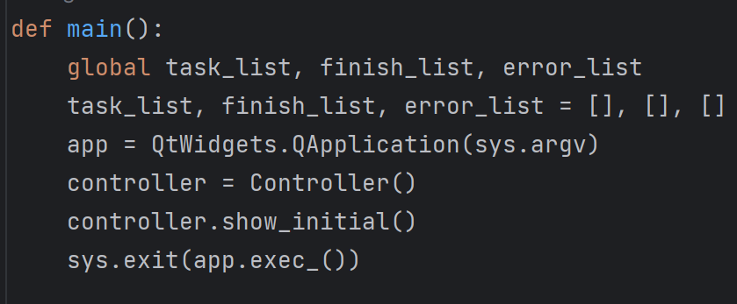
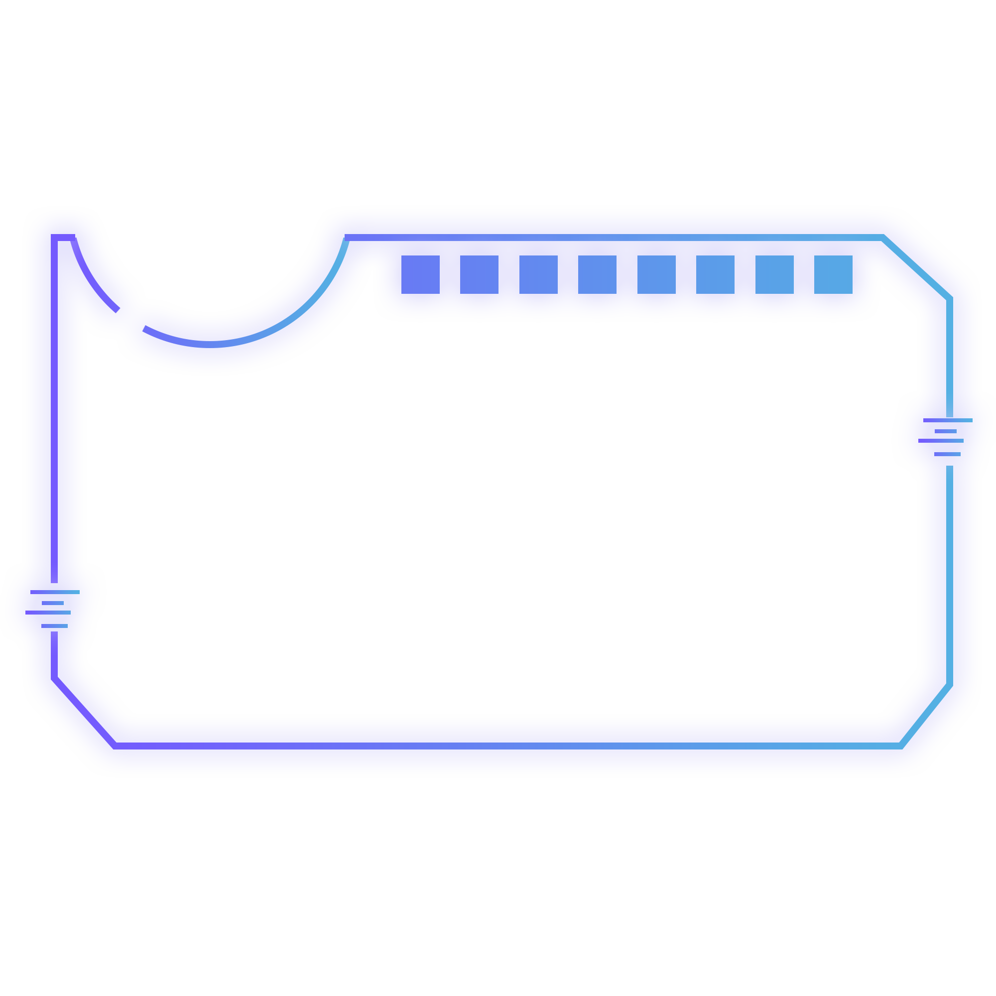
2
Process loop: two blocks, one used to control the task input and the other used to control the task process.
Task input section: If the user inputs a task, run the input-a-task function and pass in the corresponding parameters
Task process control section: Run the run_for_each_second function, sleep for 1 second

Slide 11
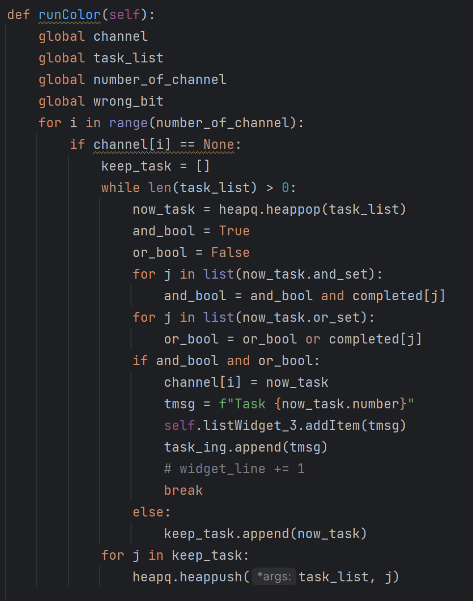
3.1
Display progress with squares of different colors

Slide 12
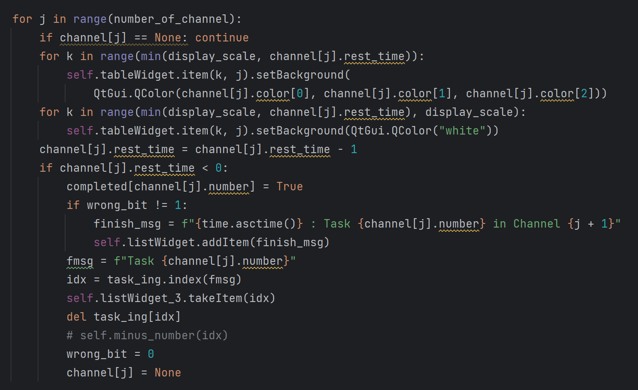
3.2
Display progress with squares of different colors, with the judgement of whether a task finishes.

Slide 13
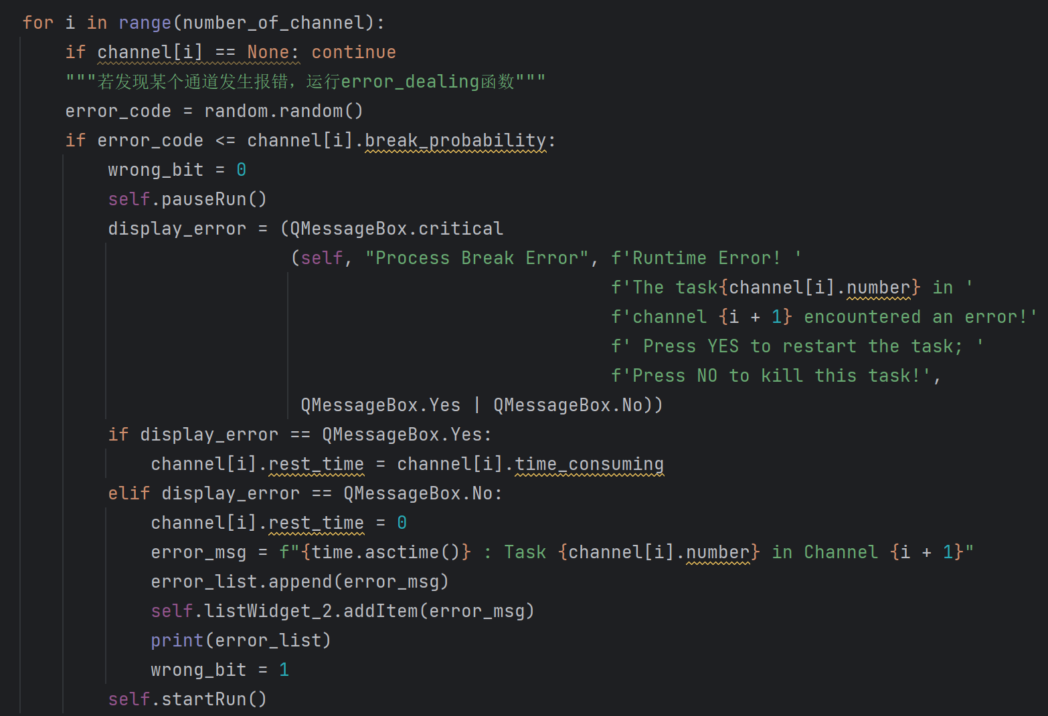
4
Error processing

Slide 14
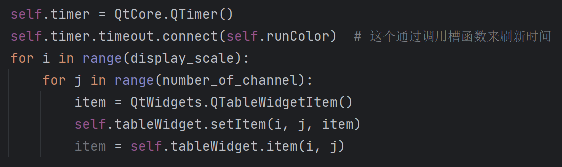
5
Refresh time by calling slot function

Slide 15
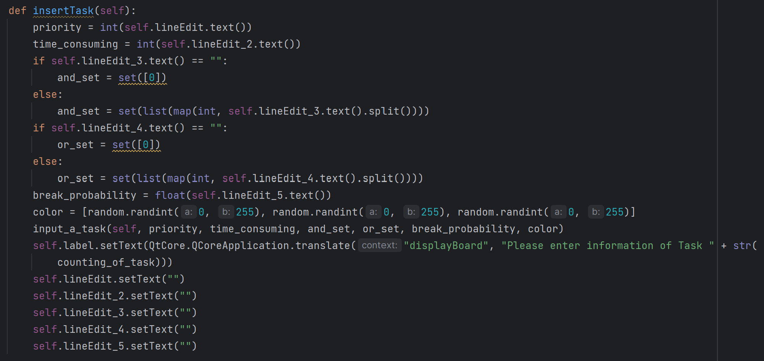
6
insert the tasks

Slide 16
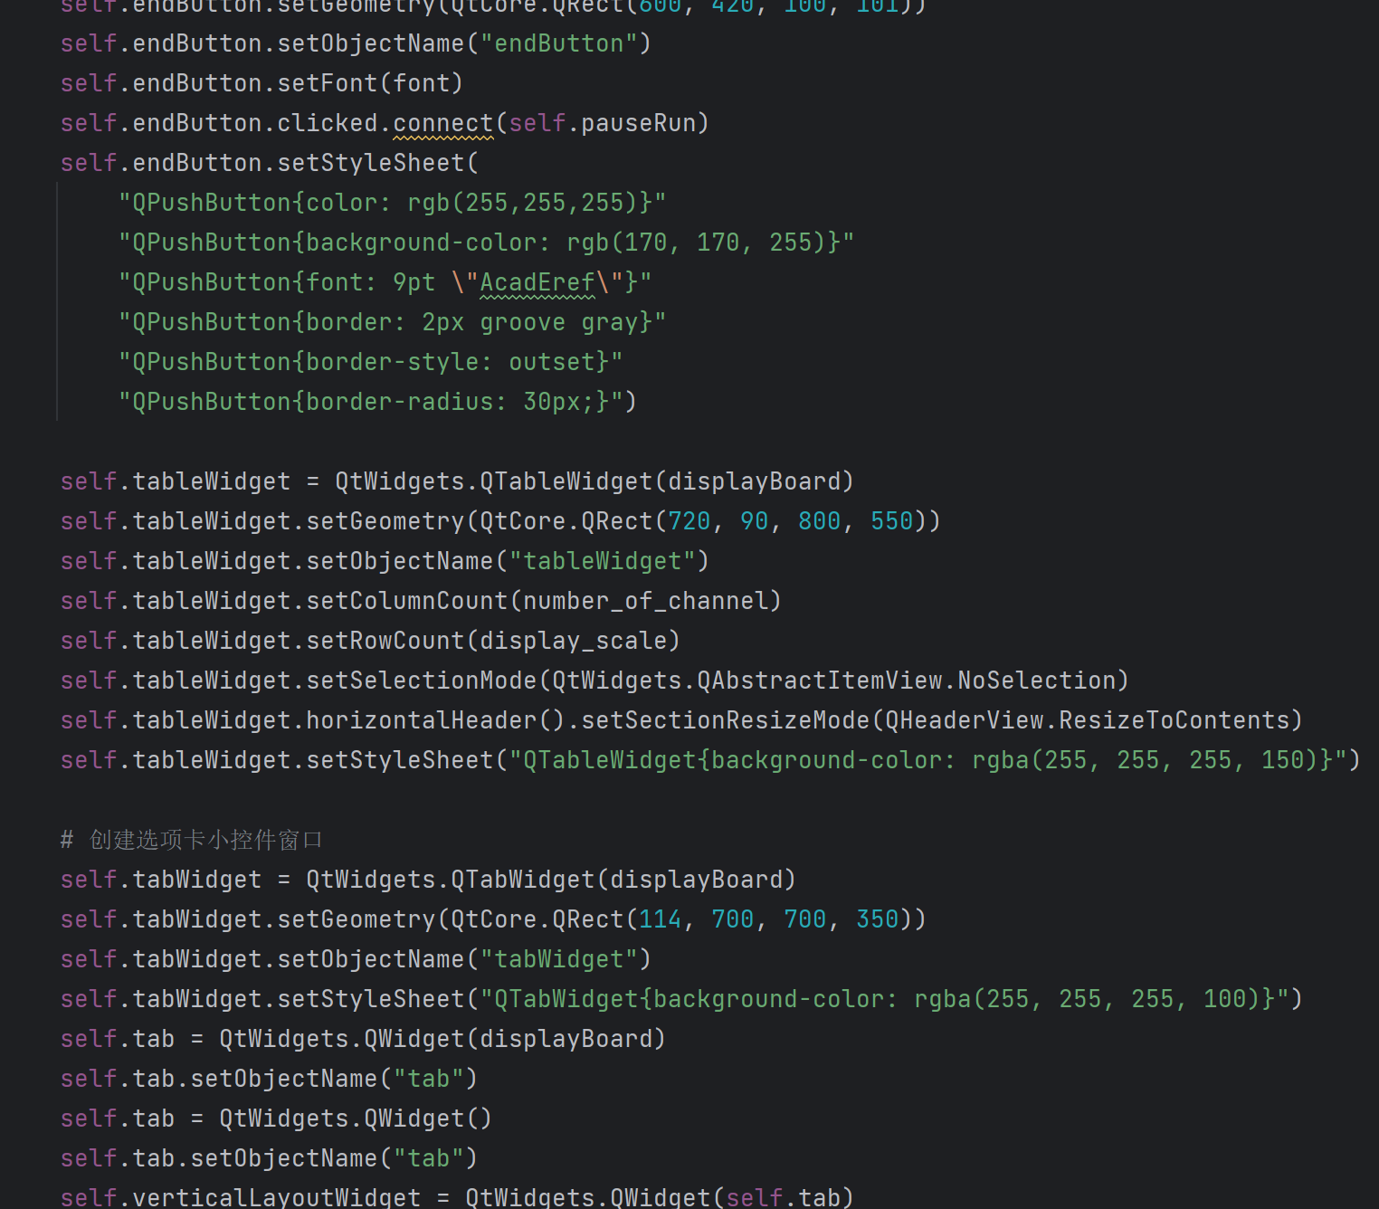
6
Since the codes about UI is too long, we only demonstrate a part of it as an example

Slide 17
Show Results

Slide 18
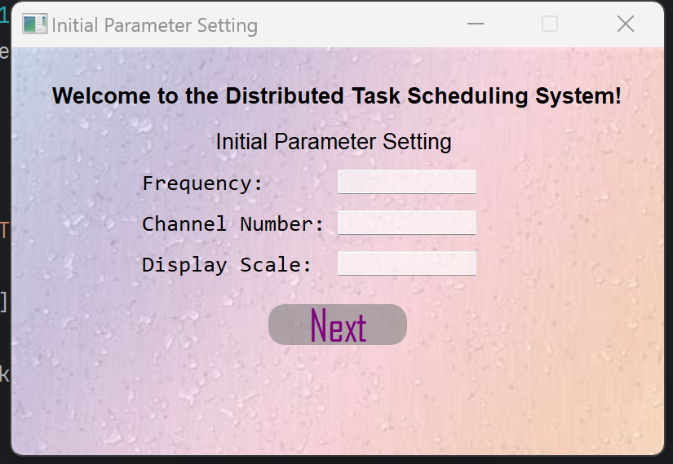
1. Brief View 1
Open the program, and the starting window is shown. User can complete the initial parameter setting in these blanks, including Frequency, Channel Number, Display Scale.
Frequency value means the update will happen in every “frequency” second. Channel Number means how many pipelining will be executing at the same time. Display Scale value means the display widget will show the information from time zero to that value.
If user enters nothing in the blank, these parameters are set defaultly as: Frequency=1, Channel Number=4, Display Scale=5.

Slide 19
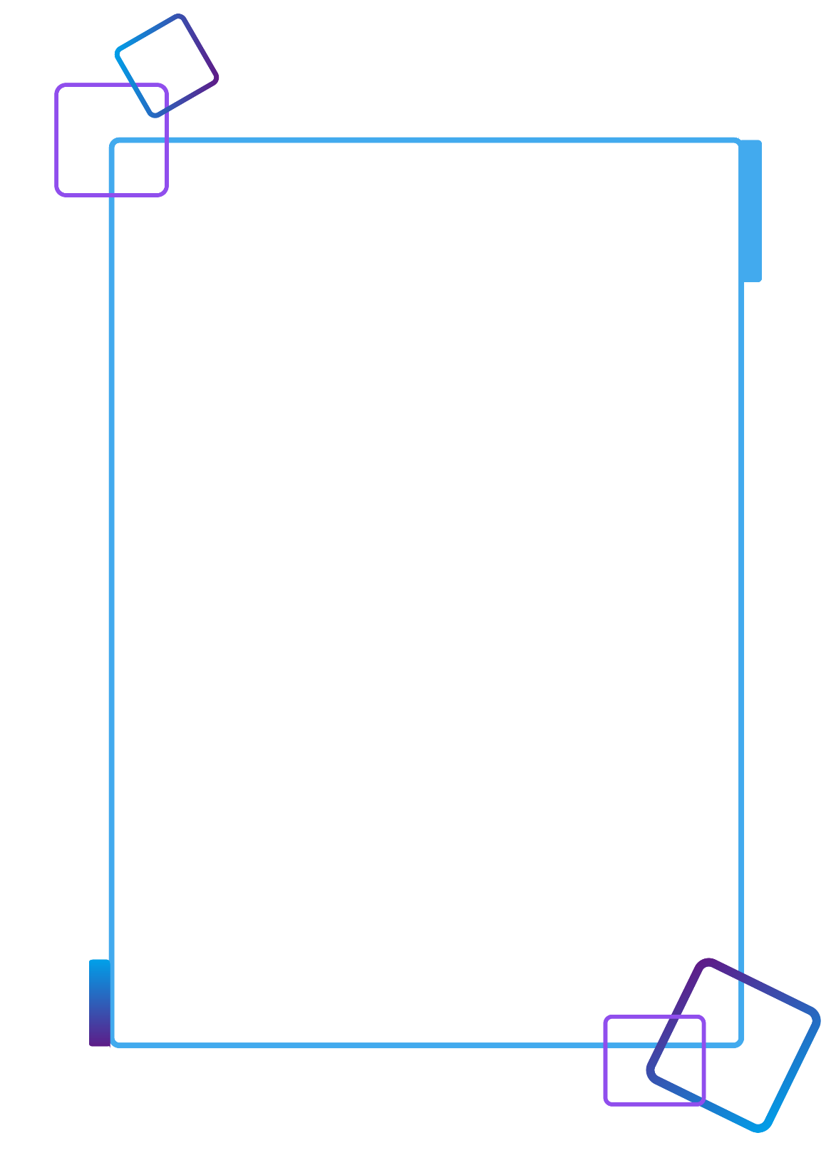
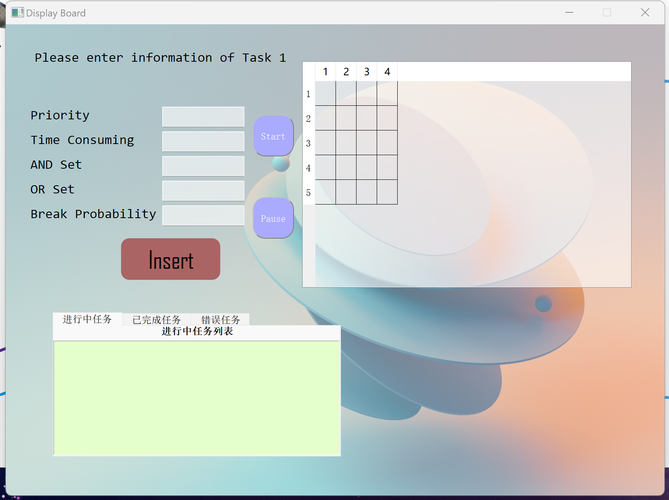
1. Brief View 2

Slide 20
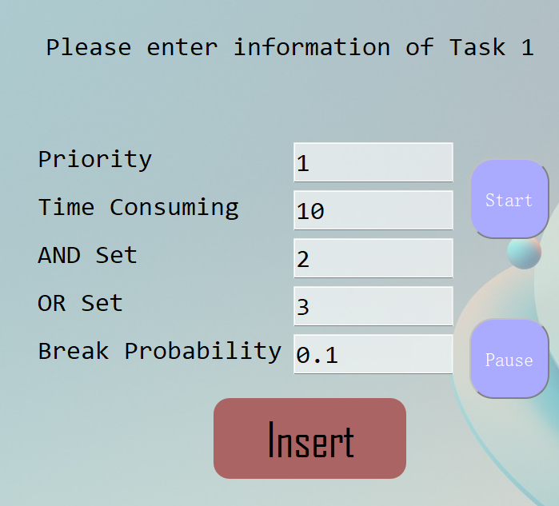
1. Brief View: Input Task
Priority means its priority in the priority queue for execution. A higher priority value means this task will be perform preferentially.
Time Consuming means the task will occupy the channel for that long of seconds.
And Set means this task would be perform if and only if all task in this set are completed.
Or Set means this task would be perform if at least one task in this set are completed. The input of these sets are list of integers separated by blank. If the task has no And Or constraint, user can input 0 or nothing.
Break Probability means at any execution second, the task will have this value of probability to break.
Click “Insert” button and add this task to the task list. Task can be inserted whenever the program is running or paused.

Slide 21
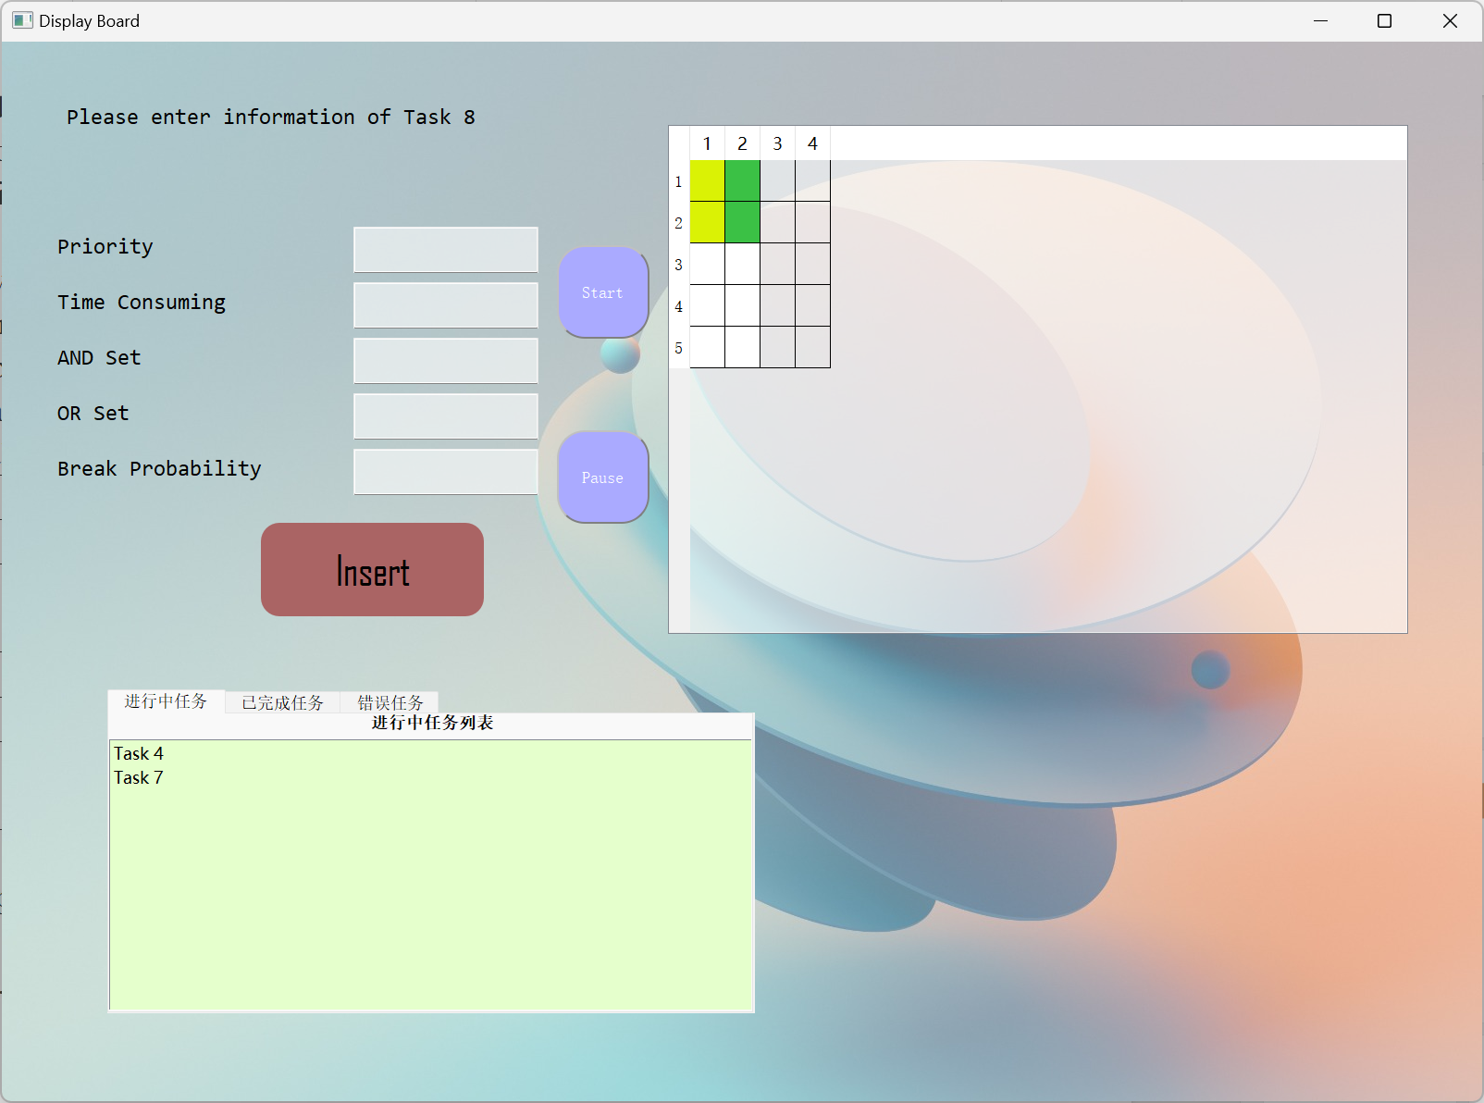
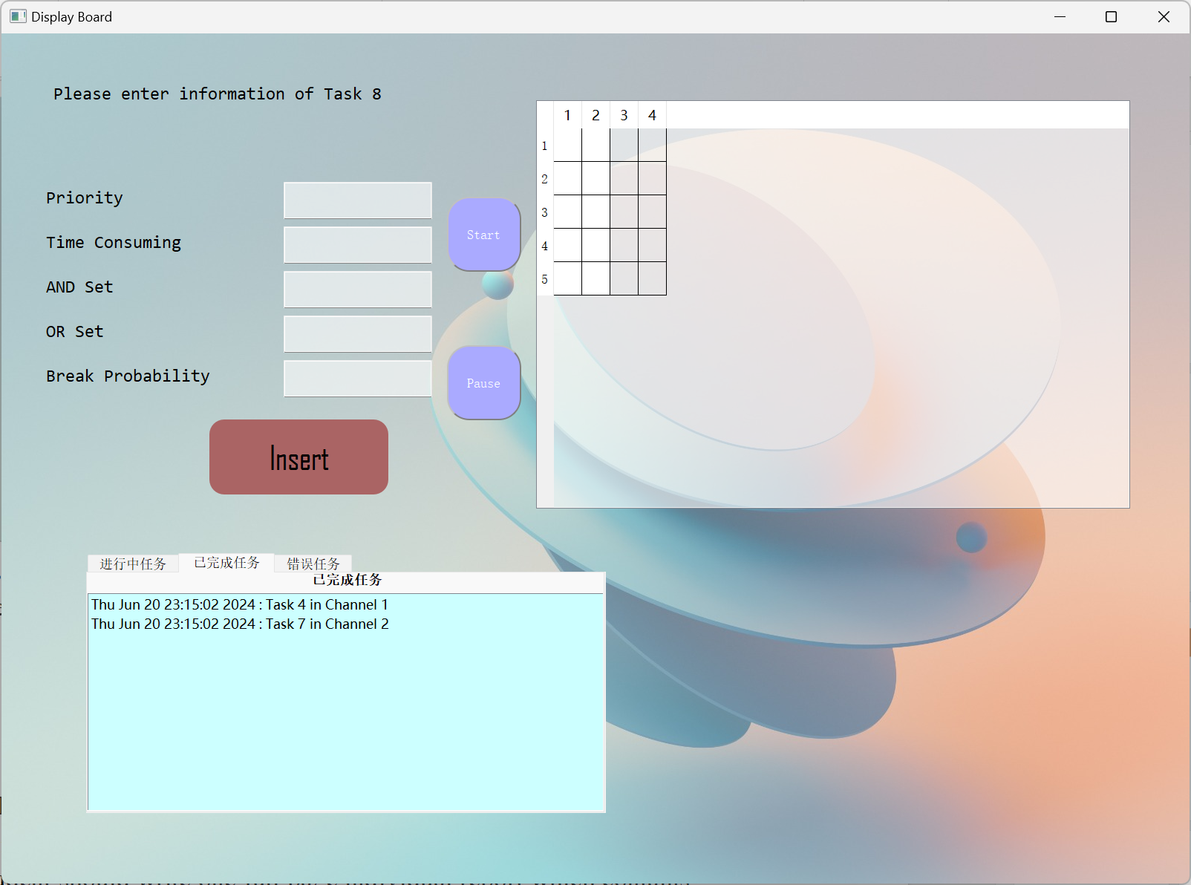
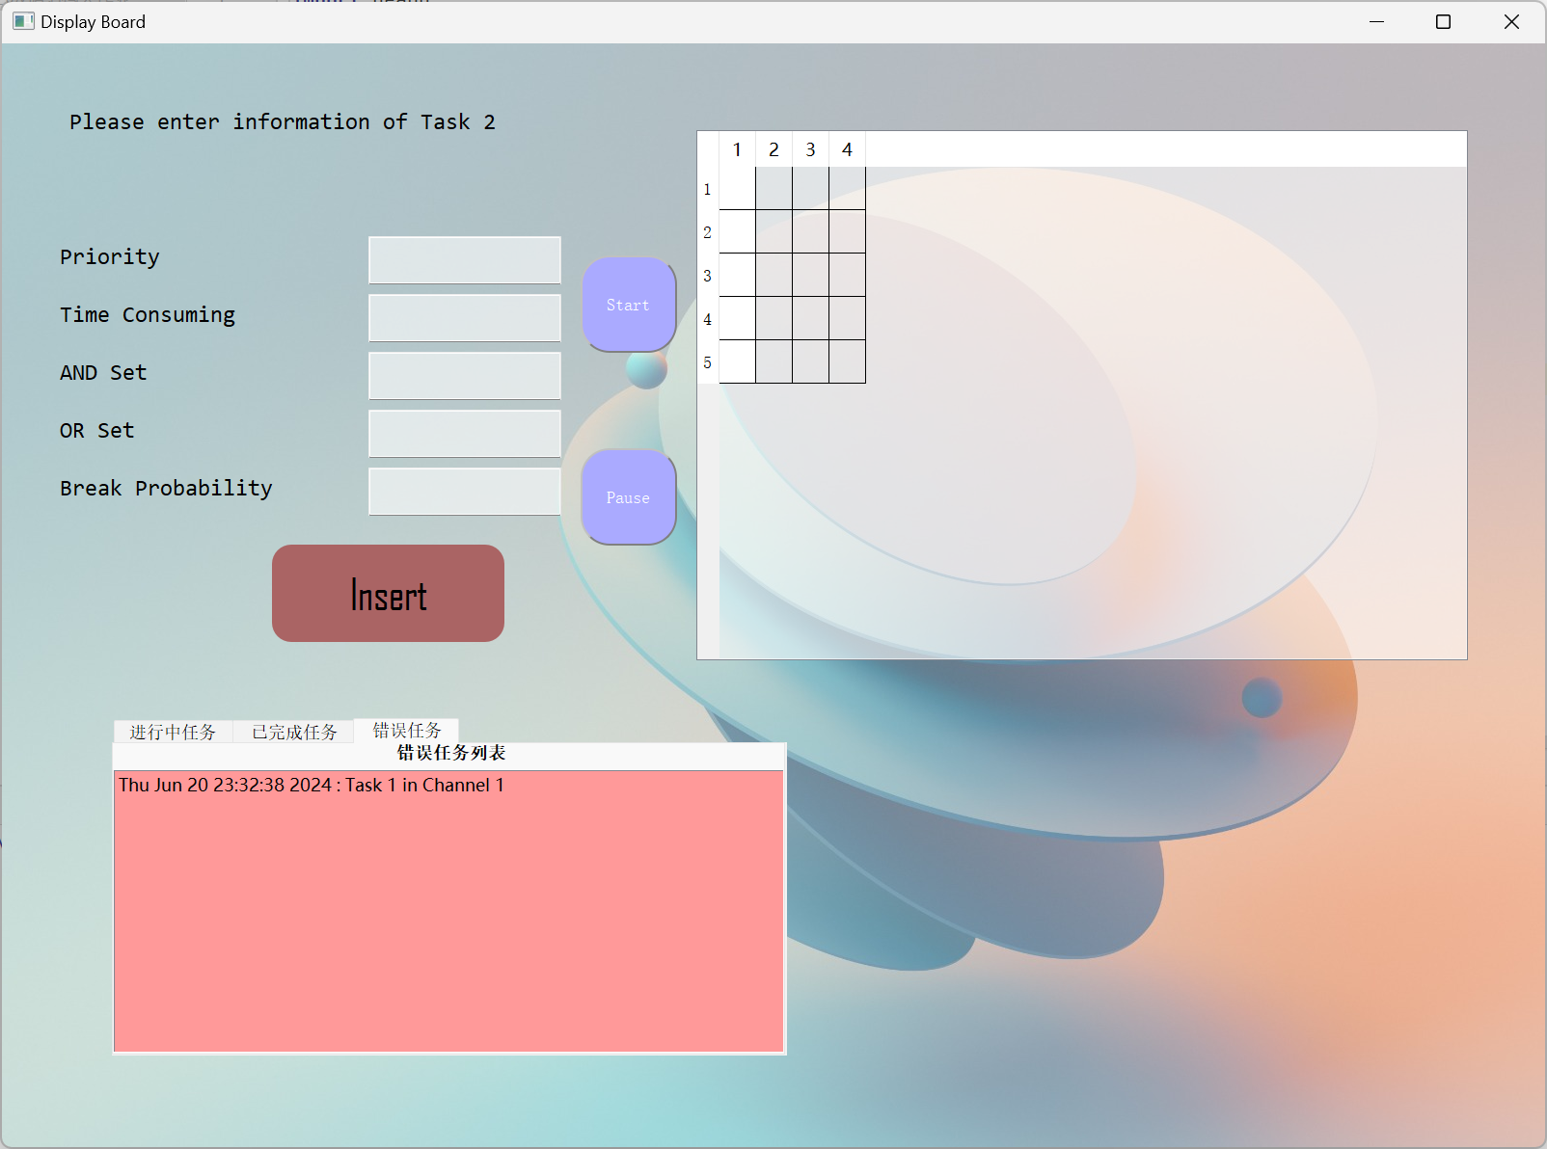
1. Brief View: processing/finished/error

Slide 22
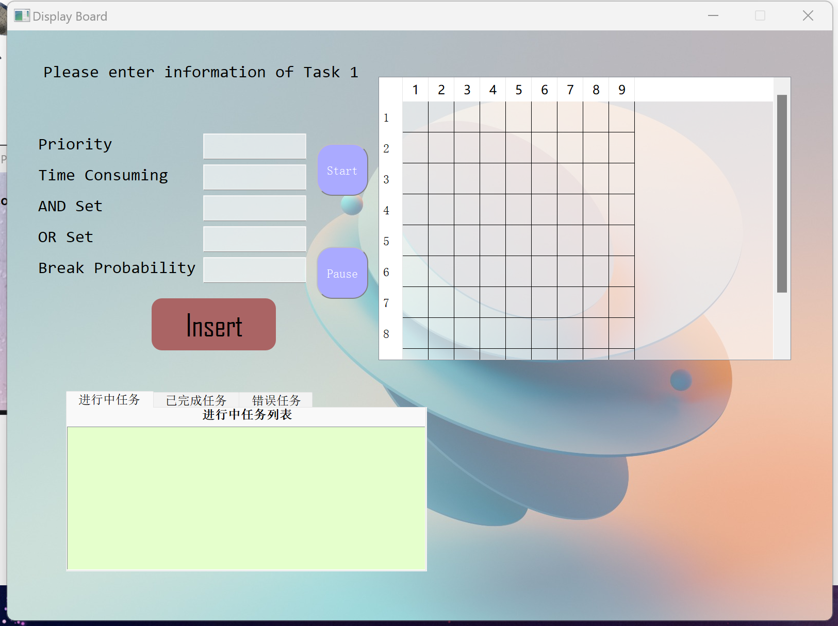
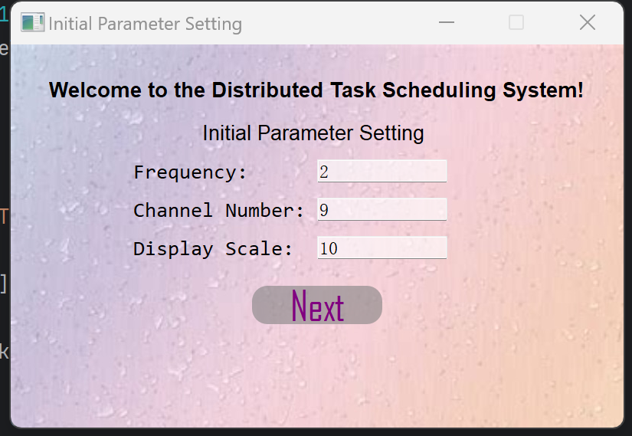
2. Initialization

Slide 23
3. In Execution
For demonstration, we insert the tasks with following parameters, for convenience, all Break Probability are set to 0:
Task | 1 | 2 | 3 | 4 | 5 | 6 | 7
Priority | 1 | 1 | 2 | 1 | 3 | 1 | 4
Time Consuming | 5 | 4 | 7 | 2 | 6 | 3 | 2
And Set |  | 1 4 6 |  |  | 7 | 1 2
Or Set | 5 |  | 1 2 6 7
Break Probability | 0 | 0 | 0 | 0 | 0 | 0 | 0

Slide 24
3. In Execution
The display widget at the top-right corner shows the remained time for a task to occupy each channel, represented by the number of colored blocks. Each task has an unique represented color. In every execution cycle, a colored block will be faded, which means the task has completed one exection time.
After all expected tasks are inserted, user can click “Start” button to run the tasks. User can click “Pause” button to stop the program and click “Start” button again to restart running.
The processing task list is shown at the bottom-left corner. For example, Task 4 and Task 7 are scheduled to perform firstly here.

Slide 25
3. In Execution
When the task has no colored block, it is completed and moves to the complete task list at the bottom-left corner.

Slide 26


3. In Execution
Then, the program will fetch the next available task into an idle channel for execution. These tasks will then recorded in the processing task list and run like below.

Slide 27
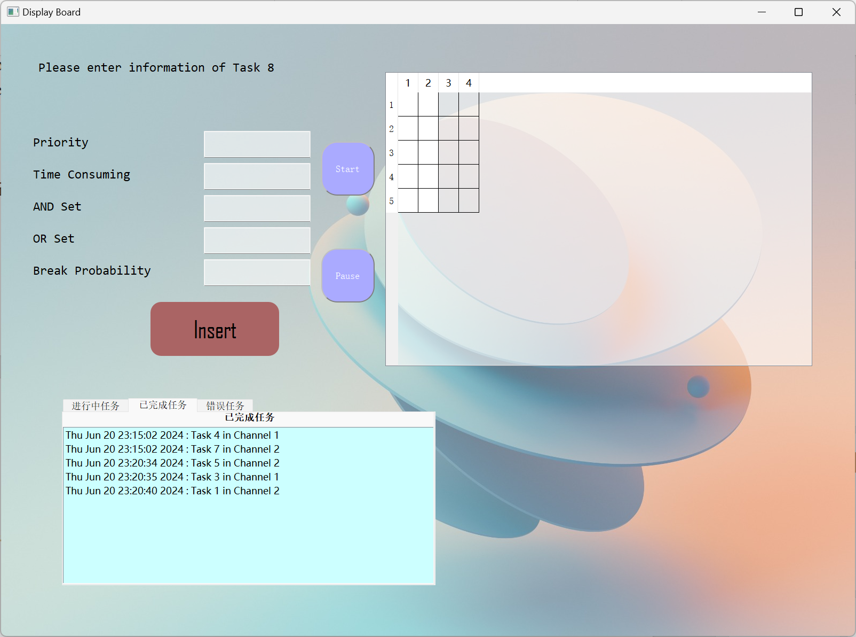
3. In Execution
Here shows the completed task list when all available operations are completed. It can be noticed that the task performed order is based on the And Or Set constraints. In addition, Task 2 and Task 6 are not performed because their And Or Set constraints would never be satisfied.

Slide 28
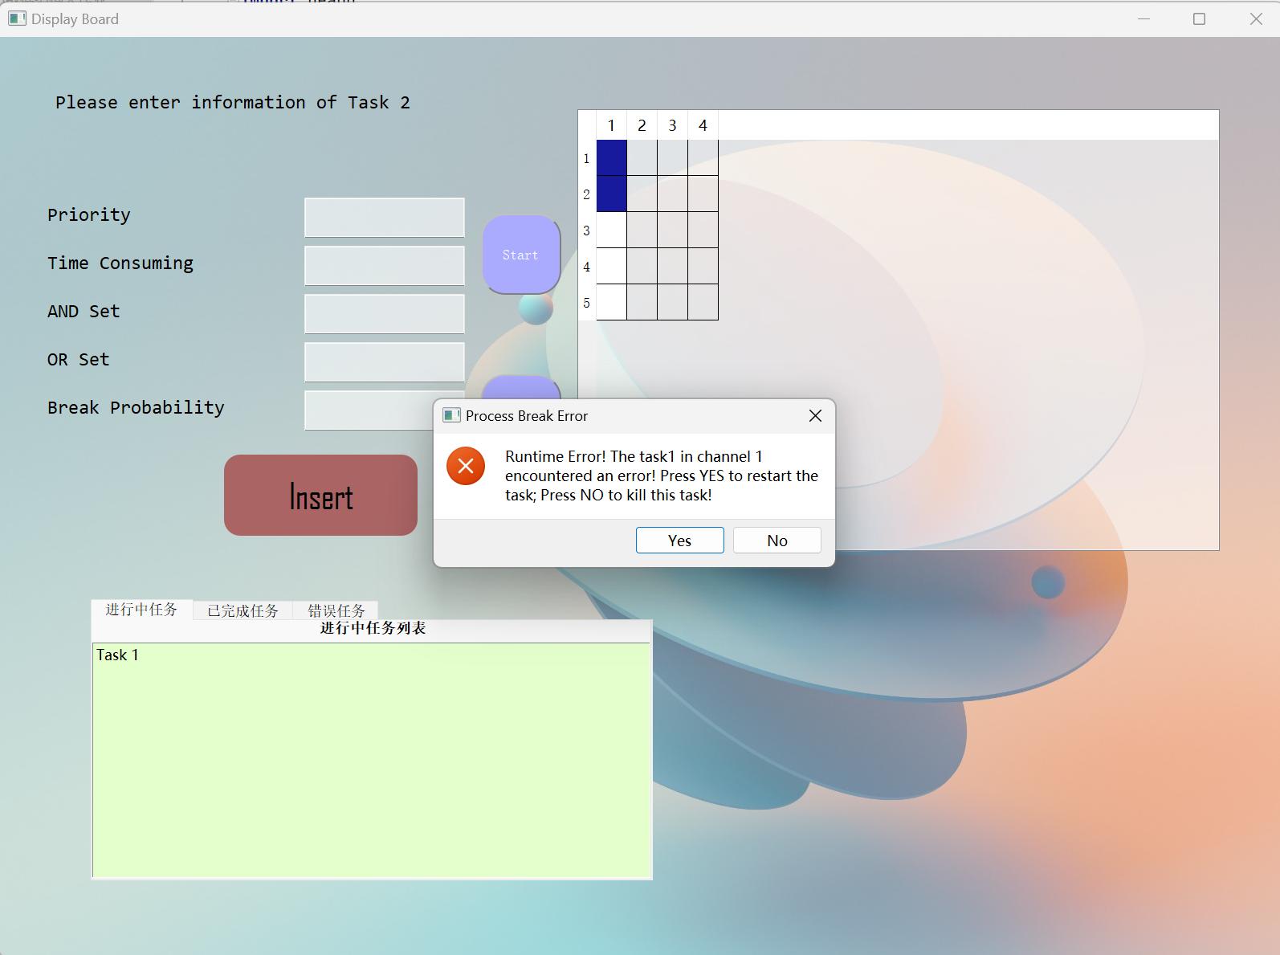
3. In Execution
A Break situation is demonstrated with the following task specified:
Task | Priority | Time Consuming | And Set | Or Set | Break Probability
1 | 1 | 4 |  |  | 0.5
After the task information is inserted, we start running the program and find that this task break at the 2rd second. Meanwhile, the program is automatically paused.

Slide 29
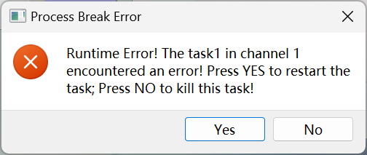
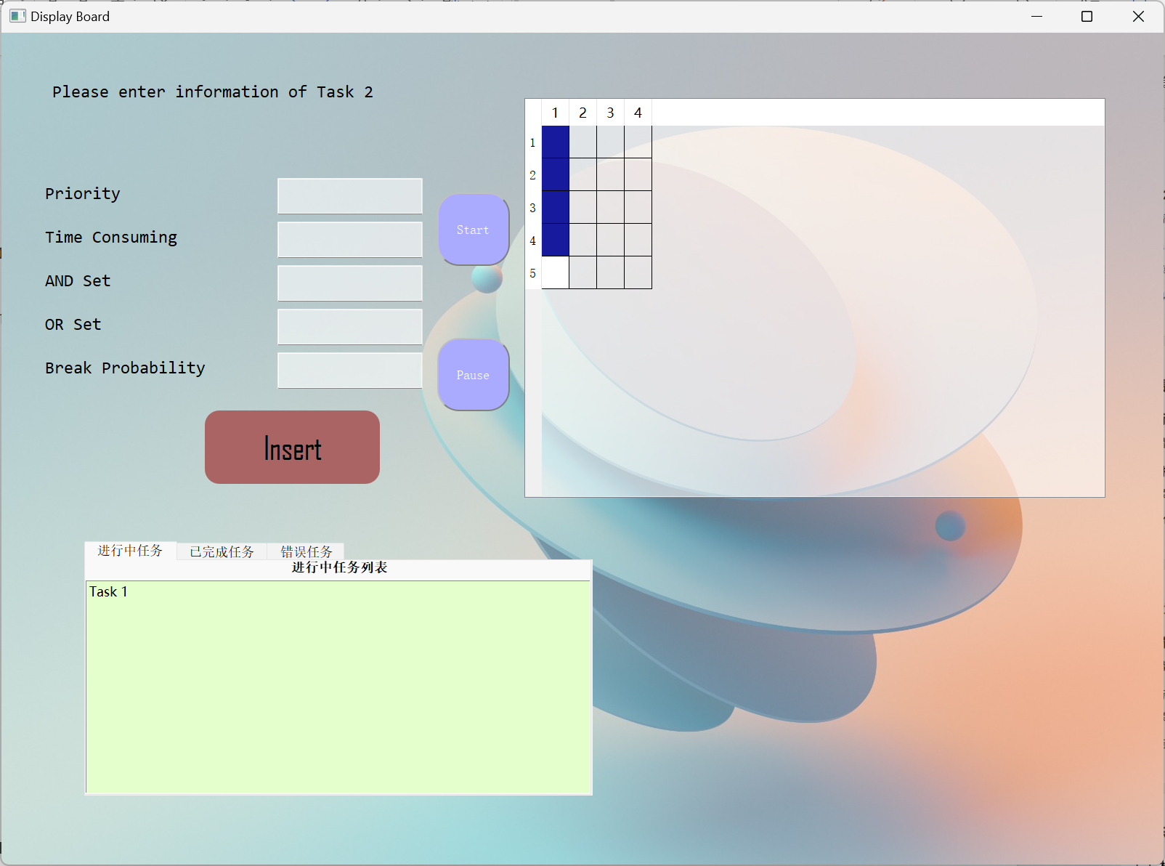
3. In Execution
A warning window will jump out and force user to choose restart the task or kill the task.
If user choose “Yes” to restart the task, it will be performed for the initial consuming time.
If user choose “No” to kill this task, it will be recorded in the error task list at the bottom-left corner. Meanwhile, the channel is cleared.

Slide 30
Thanks

